Slide 1
Data Science Engineering Methods and Tools Lecture 2
Northeastern University
College of Engineering
Multidisciplinary Graduate Engineering Department
INFO 6105 – Fall 2024
Instructor: Abdolreza Mosaddegh

Slide 2
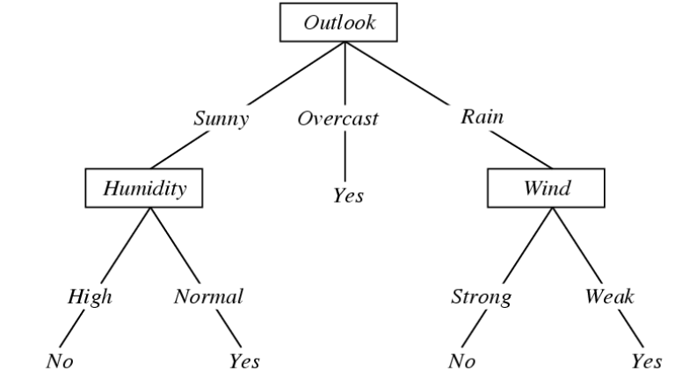
Decision Tree
A decision tree is a hierarchical classification model that uses a tree structure and can be used to support decisions
Each internal node represent a test on one attribute (feature)
Each branch from a node represents a possible outcome of the test
Each leaf node represents a class label
Prediction: Rainy and Strong Wind > Play Tennis or Not?

Slide 3
Decision Tree - Supervised Learning
data point
Prediction: Rainy and Strong Wind > Play Tennis or Not?

Slide 4
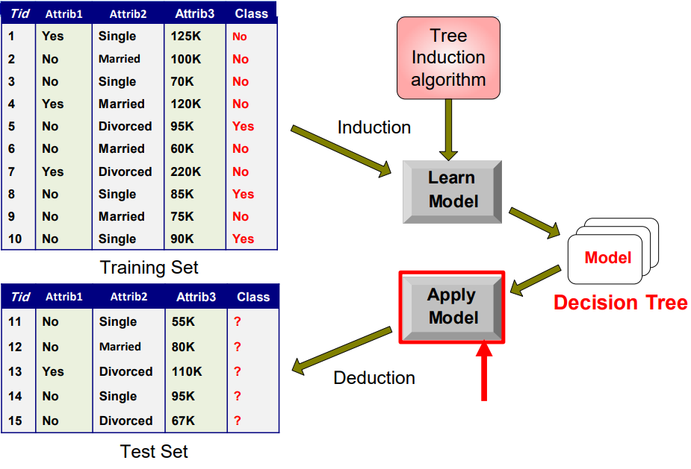
Induction and Deduction in D-Tree

Slide 5
Creating a D-Tree from Training Data

Slide 6
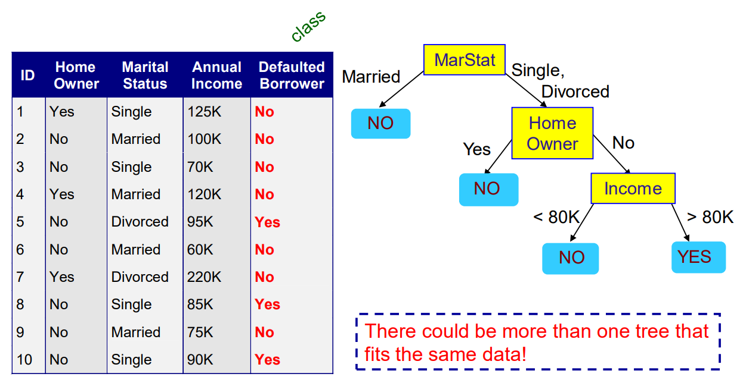
Another D-Tree with the Same Data
Which D-Tree is better?

Slide 7
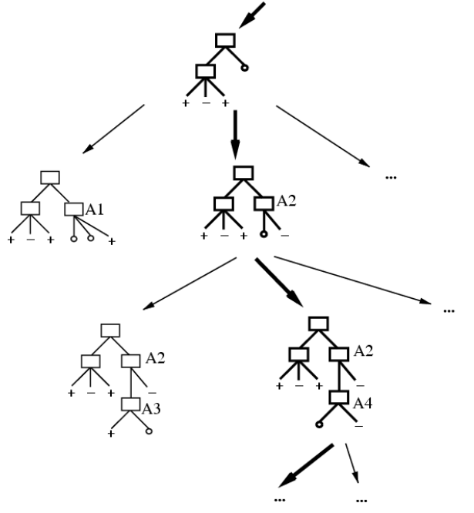
Problem Statement: Which Tree?
Occam’s razor:
In philosophy, Occam's razor is a problem-solving principle that recommends searching for explanations constructed with the smallest possible set of elements.
Occam's razor has gained strong empirical support in statistics and machine learning.
Based on Occam’s razor principle, the smallest decision tree that correctly classifies training examples is the best.

Slide 8
Smallest Tree
Learning the simplest (smallest) decision tree is an NP-complete problem [Hyafil & Rivest]
Resort to a greedy approach: Greedy algorithms make a locally optimal choice at each step that approximate a globally optimal solution in a reasonable amount of time.
• A greedy algorithm for finding smallest tree:
- Start from empty decision tree
- Split on next best attribute (feature)
- Recurse
Sometimes, a greedy strategy does not produce a global optimal solution, but just can yield locally optimal outcomes.

Slide 9
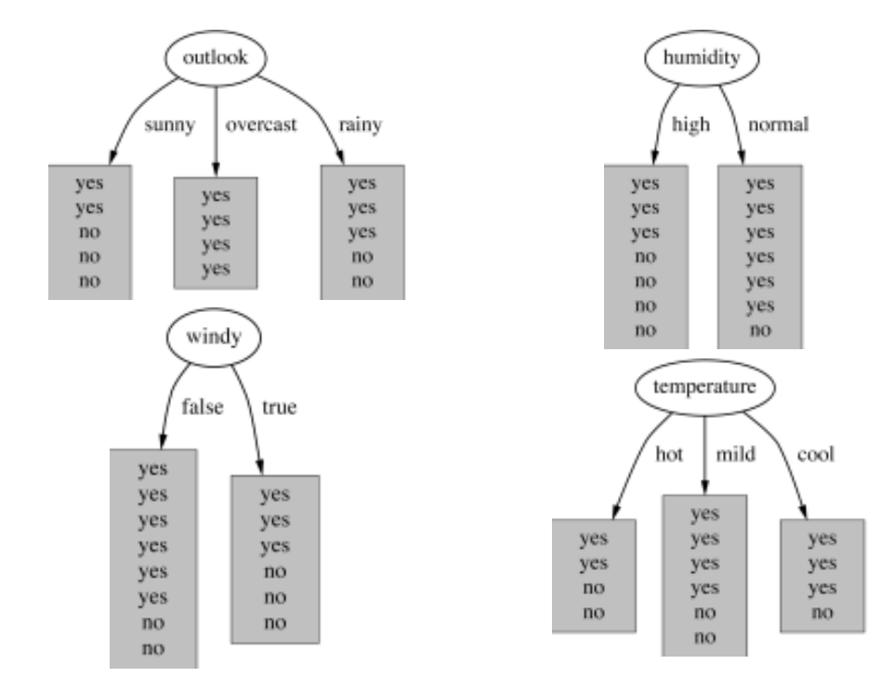
Which Attribute is the Best?
Heuristic:
choose the attribute that produces best classification (the “purest” nodes)

Slide 10
Impurity as Loss Function
Impurity is presence of more than one class in a subset of data
Impurity measures are used in Decision Trees as a loss function.
Learning process tries to find lowest impurity as possible

Slide 11
Gain
Which spilt decreases impurity more?
Gain = Impurity before spilt – Impurity after spilt
Bigger gain indicates more decrease in impurity after split

Slide 12
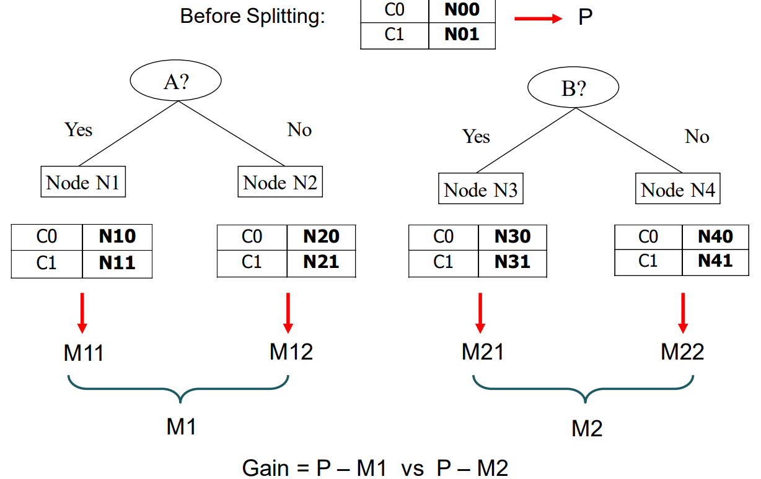
Splitting by Gain
1- Compute impurity measure (P) before splitting
2- Compute impurity measure (M) after splitting by any attribute
Compute impurity measure of each child node
Compute the weighted average impurity of the children
3- Calculate gain as follows:
Gain = P – M
4- Choose the attribute test condition that produces the highest gain
This method needs a measure to quantify impurity

Slide 13
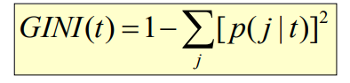
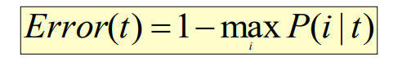
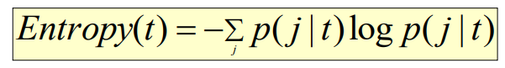
Impurity Measures
For a given node t (p( j | t) is the relative frequency of class j at node t)
• Gini Index
• Classification error
• Entropy

Slide 14
Gini Index
Gini Index for a given node t :
p( j | t) is the relative frequency of class j at node t
The Gini coefficient measures the inequality among the values of a frequency distribution
– Maximum (1 - 1/Number_of_classes ) when records are equally distributed among all classes, implying least interesting information
– Minimum (0) when all records belong to one class, implying most interesting information
When a node p is split into k partitions :

Slide 15
C1 | 5
C2 | 1
P(C1) = 5/6 P(C2) = 1/6
C1 | 0
C2 | 6
Gini = 1 – (5/6)^2 – (1/6)^2 = 0.27
P(C1) = 0/6 P(C2) = 6/6
C1 | 3
C2 | 3
Gini = 1 – (0/6)^2 – (6/6)^2 = 0
P(C1) = 3/6 P(C2) = 3/6
Gini = 1 – (3/6)^2 – (3/6)^2 = 0.5

Slide 16
D-Tree using Gini - Example
Create a decision tree on the following dataset using Gini :
Glucose | BMI | Class
Low | Low | NoDiabetes
High | High | NoDiabetes
High | Low | Diabetes
Low | Low | NoDiabetes

Slide 17
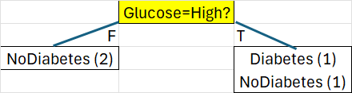
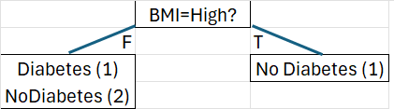
DTree - Step 1
Gini before splitting= 1 - (3/4)^2 - (1/4)^2=0.375
Gini = 1 - (2/2)^2=0 Gini = 1 - (1/2)^2 - (1/2)^2 =0.5
Gini by Glucose= (2/4 * 0 )+ (2/4 * 0.5)=0.25
→ Gain = 0.375 – 0.25 = 0.125
Gini before splitting = 1 - (3/4)^2 - (1/4)^2=0.375
Glucose | BMI | Class
Low | Low | NoDiabetes
High | High | NoDiabetes
High | Low | Diabetes
Low | Low | NoDiabetes
Gini = 1 - (1/3)^2 - (2/3)^2=4/9 Gini = 1 - (1/1)^2 =0
Gini by BMI=(3/4 * 4/9) + (1/4 * 0)=0.333
→ Gain = 0.375 – 0.333 = 0.042

Slide 18
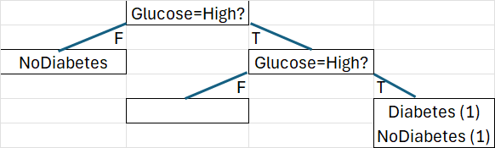
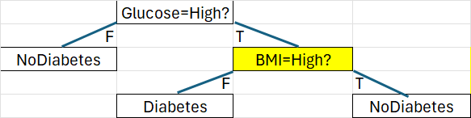
DTree - Step 2
Gini before splitting = 1 - (1/2)^2 - (1/2)^2 =0.5
Gini = 0 Gini = 1 - (1/2)^2 - (1/2)^2 =0.5
Gini by Glucose= (0 * 0) + (2/2 * 1/2) =0.5
→ Gain = 0.5 – 0.5 = 0
Glucose | BMI | Class
Low | Low | NoDiabetes
High | High | NoDiabetes
High | Low | Diabetes
Low | Low | NoDiabetes
Gini = 1 - (1/1)^2 =0 Gini = 1 - (1/1)^2 =0
Gini by BMI=(1/2 * 0)+ (1/2 * 0) =0 → Gain = 0.5 – 0 = 0.5
(Since impurity is 0, we stop splitting the tree)

Slide 19
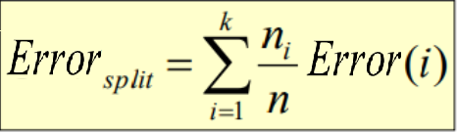
Classification Error
Classification error at a node t:
Measures misclassification error made by a node.
– Maximum (1 - 1/Number_of_classes) when records are equally distributed among all classes, implying least interesting information
– Minimum (0) when all records belong to one class, implying most interesting information
When a node p is split into k partitions :

Slide 20
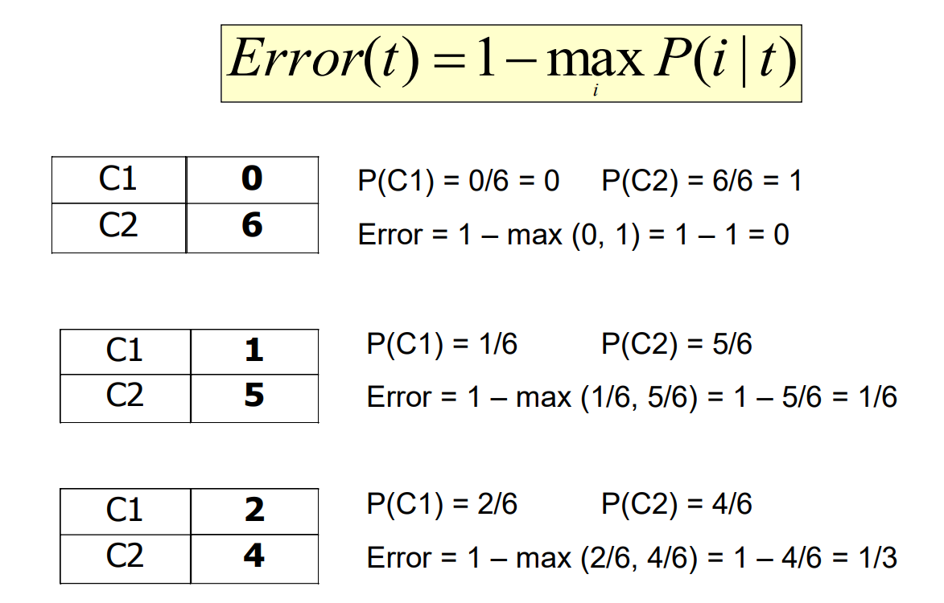

Slide 21
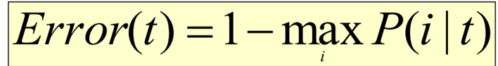
DTree - Step 1
Misclassification= 1 - 2/2 = 0 Misclassification= 1 - 1/2 = 1/2
Misclassification by Glucose= (2/4 * 0)+ (2/4 * 1/2)=0.25
Glucose | BMI | Class
Low | Low | NoDiabetes
High | High | NoDiabetes
High | Low | Diabetes
Low | Low | NoDiabetes
Misclassification= 1 - 2/3 = 1/3 Misclassification= 1 - 1/1 = 0
Misclassification by BMI=(3/4 * 1/3) + (1/4 * 0)=0.25

Slide 22
Comparing Impurity Measures
Entropy and Gini are more sensitive to changes in the node probabilities than the misclassification error rate
For a 2-class problem

Slide 23
Entropy
Entropy at a given node t:
Entropy is commonly associated with a state of disorder or uncertainty
– Maximum (Log Number_of_classes ) when records are equally distributed among all classes implying least information
– Minimum (0.0) when all records belong to one class, implying most information
Entropy based computations are quite similar to the GINI index computations

Slide 25
Information Gain
Information gain is the reduction in entropy produced from splitting.
Information Gain after splitting parent node(p) with n records:
ni is number of records in partition i
– Choose the split that achieves most reduction in Entropy(maximizes GAIN)
– Used in the ID3 decision tree algorithm

Slide 26
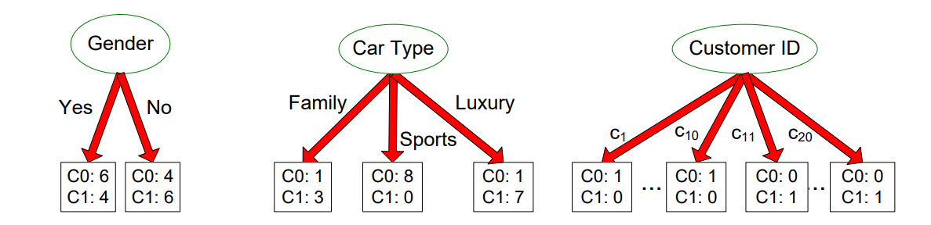
Disadvantage of information gain
• It prefers attributes with large number of values that split the data into small, pure subsets
• Quinlan’s gain ratio uses normalization to improve this
Customer ID has highest information gain because entropy for all the children is zero
information gain has the disadvantage that it prefers attributes with large number of values that split the data into small, pure subsets leads to overfitting to train dataset.

Slide 27
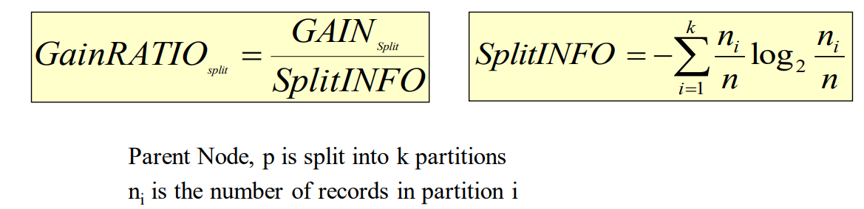
Gain Ratio (Quinlan’s Gain Ratio)
Adjusts Information Gain by the entropy of the partitioning (SplitINFO).
Large number of small partitions is penalized
Designed to overcome the disadvantage of Information Gain
Used in C4.5 algorithm

Slide 28
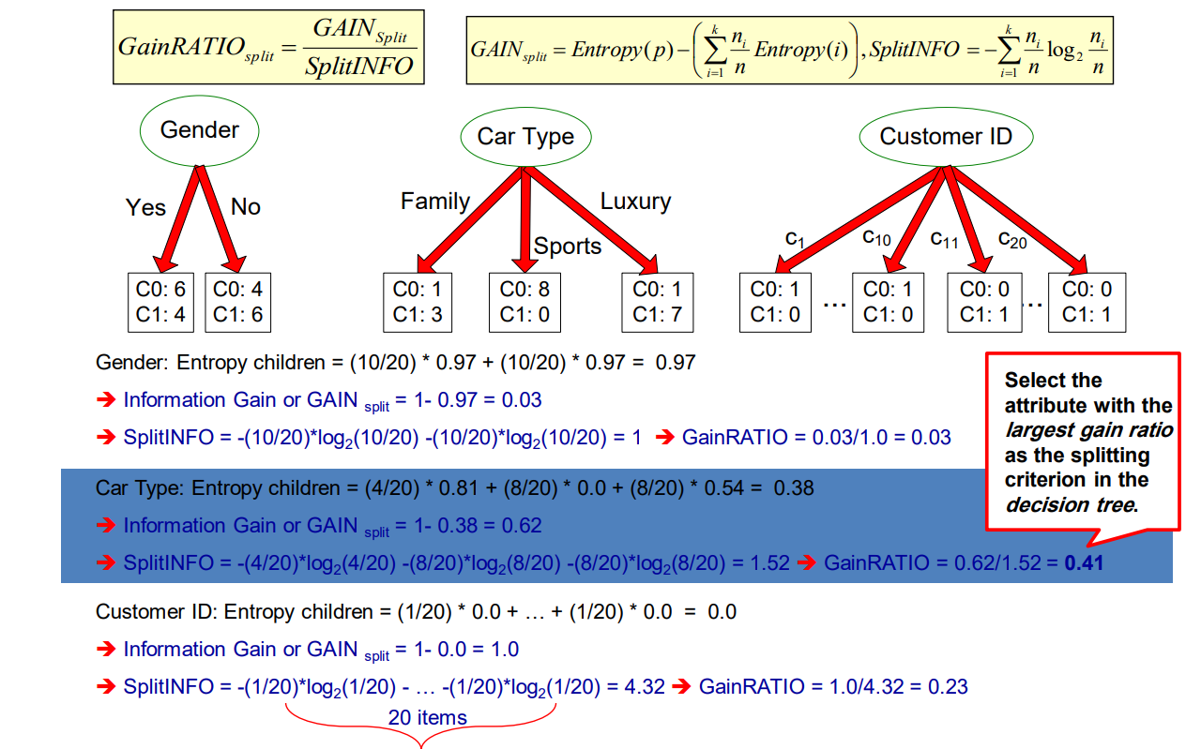

Slide 29
Stop splitting
How should the splitting procedure stop?
If all the records belong to a same class in all nodes
If all the records in any node have identical attribute values
Early termination of process by settings some limits
Growth of a decision tree leads to complexity of the model and overfitting to training data

Slide 30
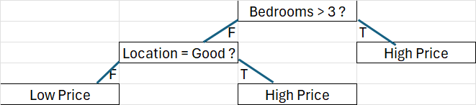
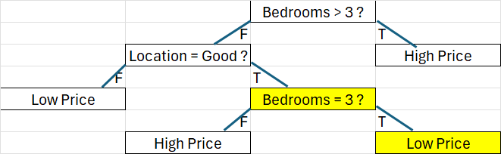
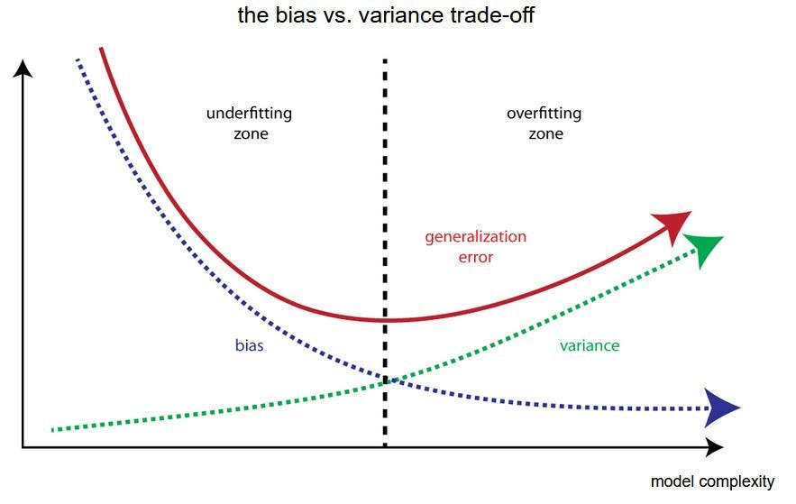
Decision Tree Overfitting- Example
Bedrooms | Location | Price
2 | Good | High Price
1 | Good | High Price
2 | Bad | Low Price
4 | Bad | High Price
4 | Good | High Price
1 | Bad | Low Price
3 | Good | Low Price
Right Fit
Accuracy = 86%
Overfitted
Accuracy = 100%

Slide 31
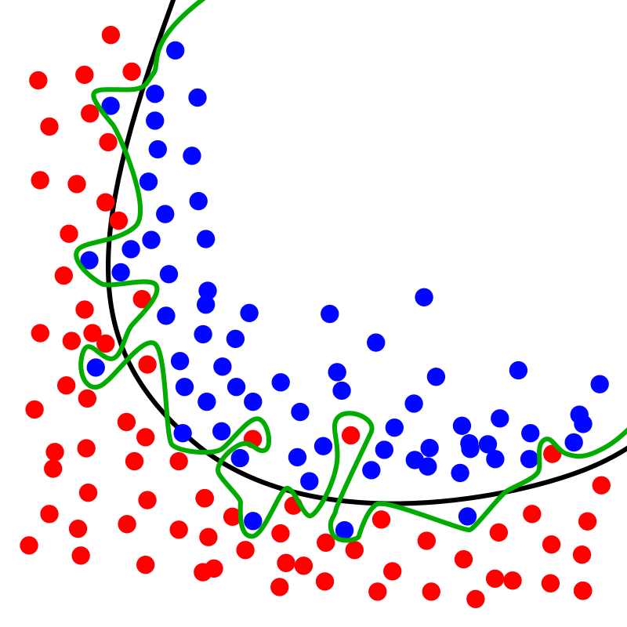
Avoid Overfitting – General Approaches
Using algorithms which are more robust against overfitting
Reducing complexity of model
Feature Reduction
Train with more data
Using validation data
…

Slide 32
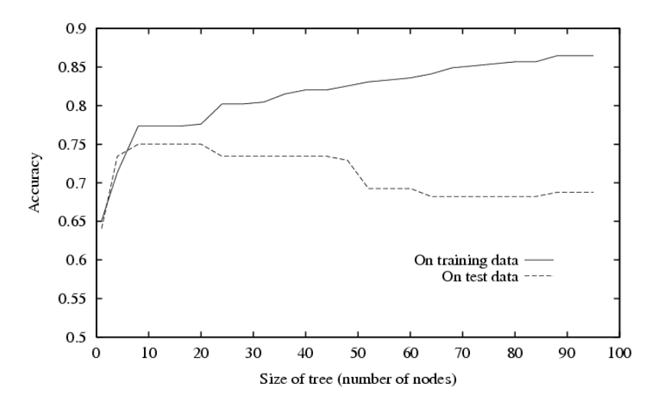
Avoid overfitting – Reduce Complexity
Two main approaches:
Reduce model complexity by stopping growth of the tree using constraints (during creation of tree)
Grow full tree, then prune to reduce model complexity
Performance of the tree degrades by adding complexity after 20 nodes

Slide 33
Stop Growth (Pre-pruning) techniques
Pre pruning stops the growth of decision tree on an early stage (to avoid complexity of model).
Complexity of a ML model make it perfect for training data but limits the generalizability of the model thus the performance degrades on test / production phase.
We can limit the growth of trees by setting constraints with optimum values using a heuristic approach.
The validation data can be used to select best constraints (Hyper-parameters).
A hyperparameter is a parameter which specifies details of the learning process, in contrast to parameters which determine the model itself.
Some of hyperparameters can be used as a constraint in decision trees are as follows:
max_depth: maximum depth of decision tree
min_sample_split: The minimum number of samples required to split an internal node:
min_samples_leaf: The minimum number of samples required to be at a leaf node
min_impurity_decrease: The minimum decrease in impurity by spliting

Slide 34
Example of Hyper-parameters

Slide 35
Post pruning techniques
Cost complexity pruning (CCP) provides an option to control the size of a tree by pruning after creating the tree.
This pruning technique adds complexity penalty to impurity.
It is parameterized by the cost complexity parameter, ccp_alpha.
As alpha increases, more of the tree is pruned, thus creating a decision tree that generalizes better.
The validation data can be used for finding optimal ccp_alpha
R(T) is the error of the subtree 𝑇.
size(T) is the number of leaves in the subtree.
α is a non-negative parameter that controls the trade-off between the tree's size and its accuracy (Larger values of α will favor smaller trees.)

Slide 36
Cost complexity - Example
T1
Error = 1 , Leaves = 3
Bedrooms | Location | Price
2 | Good | High Price
1 | Good | High Price
2 | Bad | Low Price
4 | Bad | High Price
4 | Good | High Price
1 | Bad | Low Price
3 | Good | Low Price
T2
Error = 0 , Leaves = 4
α = 0.5 → R1(T1)=1 + 0.5×3 = 2.5, α = 1 → R1(T1)=1 + 1×3 = 4 , α = 2 → R1(T1)=1 + 2×3 = 7
α = 0.5 → R1(T2)=0 + 0.5×4 = 2, α = 1 → R1(T2)=0 + 1×4 = 4 , α = 2 → R1(T2)=0 + 2×4 = 8

Slide 37
Cost complexity pruning
A decision tree is first grown to its maximum size (full size / pre-pruning constraints).
For each subtree in the decision tree, a cost complexity measure is calculated.
The subtree with the smallest increase in cost complexity is pruned.
Minimal cost complexity pruning recursively finds the node with the “weakest link”.
Path of cost complexity pruning returns the effective alphas and the corresponding total leaf impurities at each step of the pruning process.
As alpha increases, more of the tree is pruned, which increases the total impurity of its leaves.

Slide 38
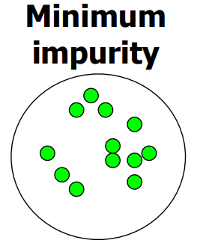
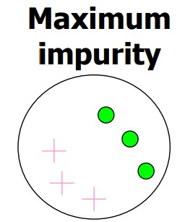
Data Preprocessing - Balancing Training Data
A dataset in which most of examples belong to a same class is not a good training set for learning (Low Impurity).
We need to balance such dataset using balancing techniques.

Slide 39
Right Assessment in Imbalanced Data
If there is a dataset with more than 90% percent of one class, a model which classifies all samples into that class will have an excellent accuracy (more than 90%).
In imbalanced data:
Loss function that is penalizing wrong classification of the rare class more than wrong classifications of the abundant class can be useful.
Resampling methods can be applied.
Sensitivity and Specificity measures can be useful besides accuracy rate.

Slide 40
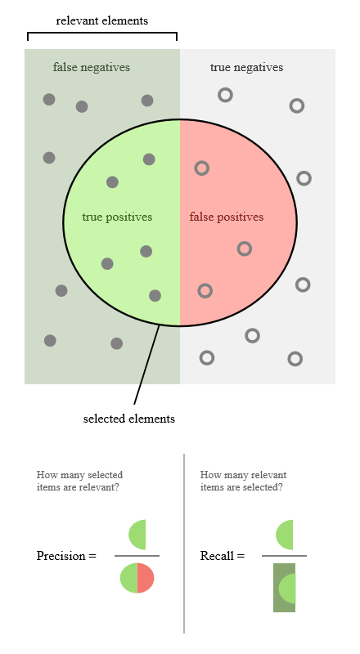
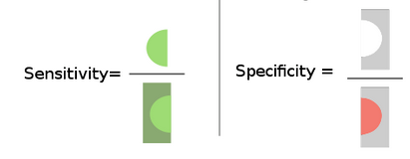
Model Assessment
Confusion Matrix

Slide 41
Resampling from Imbalanced Data
Under-sampling:
Balances the dataset by reducing the size of large classes.
This method is used when large quantity of data is available for training
Over-sampling:
Balance dataset by increasing the size of rare classes.
Oversampling is used when the size of training data is limited.
New samples are generated using repetition, bootstrapping or SMOTE

Slide 42
Data Preprocessing - Normalizing Data
Loss function in Decision Tree is impurity
Despite many ML models this loss function (impurity) is not affected by distance between feature values, therefore, normalizing features (scaling) has no impact on performance of the model.
In white-box models (e.g., Decision Tree), not just prediction but interpretability of results is important, especially if the model is used in a semi-automated decision-making process.
2,3 -> Normalizing features is not recommended since it has no effect on performance but makes results less interpretable.

Slide 43
Dealing with missing values in D-tree
All missing values assigned to a node with the biggest number of instances.
Missing values are distributed to all children proportional with the number of instances from each child node.
Missing values are distributed randomly to only one single child node.
Missing values can be handled during data pre-processing phase.

Slide 44
Splitting in D-Tree
Multi-way split:
Use as many partitions as distinct values.
Binary split:
Divides values into two subsets
Need to find optimal partitioning.
Preserve order property among attribute values
By considering performance issues, most common algorithms prefer binary split since there are too many possibilities for the next split in the multiway D-Trees

Slide 45
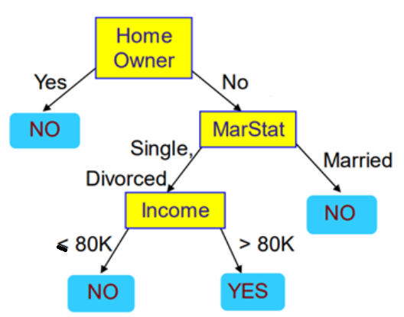
Continues Variables in Decision Trees
Greedy Algorithm (makes locally optimal choices at each step):
Continues variables are separated into two subsets by considering possible thresholds, where threshold is the midpoint between two adjacent observed values of the variable.
Income
70k
60k
90K
60K
65K
60
65
70
90
62.5
67.5
80
Income > 62.5 ? → Gain = …
Income > 67.5 ? → Gain = …
Income > 80 ? → Gain = …

Slide 46
Common D-Tree Algorithms
 | ID3 | C5.0 | CART | SPRINT | EFDT
Split Criterion | Information Gain (Entropy) | Gain Ratio (Improved from C4.5) | Gini Impurity (Classification) | Gini Impurity or Entropy | Hoeffding Bound + Gini Impurity or Entropy
Pruning | No Pruning | Post-pruning with Simplification | Cost-Complexity Pruning | No Pruning (Streaming Model) | Dynamic Pruning in Real-Time
Handling Missing Values | Not Handled | Handled by Probabilities | Surrogate Splits or Imputation | Handled using Lists | Not directly handled, assumed to be rare
Parallelism | Not inherently parallel | Not inherently parallel | Not inherently parallel | High, supports parallel processing | High, designed for real-time processing
Use Cases | Basic Classification | Advanced Classification | Classification & Regression | Very large-scale datasets | Real-time decision making, streaming data

Slide 47
Convert Decision trees to IF-THEN rules
Bedrooms | Location | Price
2 | Good | High Price
1 | Good | High Price
2 | Bad | Low Price
4 | Bad | High Price
4 | Good | High Price
1 | Bad | Low Price
3 | Good | Low Price
Right Fit
Accuracy = 86%
It is possible to extracted a rule for each leave node:
If Bedrooms > 3 then Price=High Price
If Bedrooms <= 3 and Location = Good then Price=High Price
If Bedrooms <= 3 and Location <> Good then Price=Low Price

Slide 48
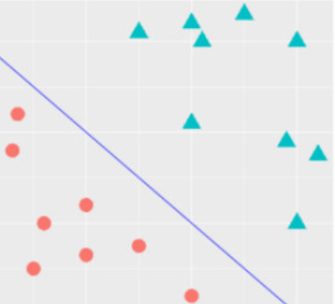
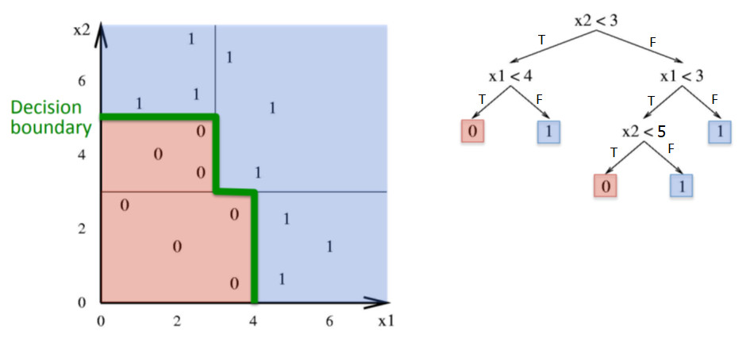
Decision Tree as a Non-linear Classifier
Decision trees divide the feature space into axis-parallel rectangles
Linear
Non-linear

Slide 49
D-Tree Advantages
Handle non-Linear classification
Interpretability of results
Transparency in producing results (White-box model)
Accuracy is reasonable for most uncomplex problems
Model transparency supports semi-automated decision making suitable for many applications
Decision trees are able to generate understandable rules.

Slide 50
D-Tree Disadvantages
Accuracy is less than some advanced ML techniques (e.g., DNNs) for some complex classification / prediction problems
Decision trees are prone to errors in classification problems with small number of training examples.
The processes of growing and pruning of decisions tree are computationally expensive
The Decision trees are prone to overfitting problem.
A small change in the training data can lead to a completely different tree structure, making decision trees unstable

Slide 51
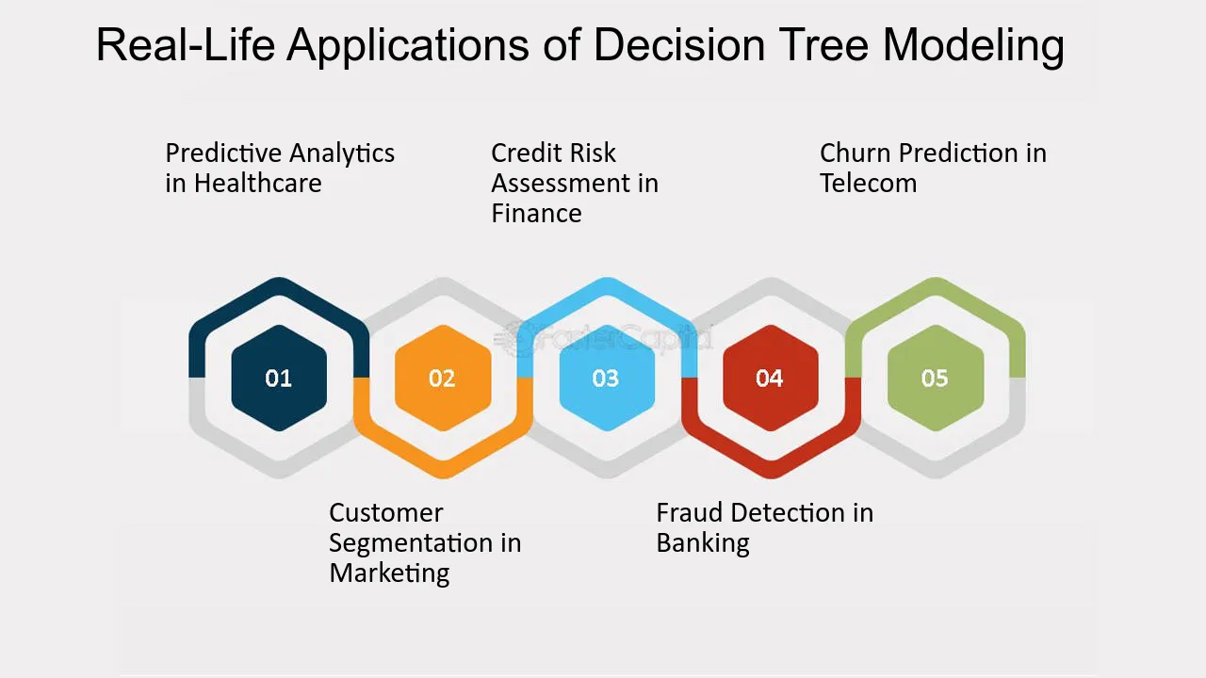
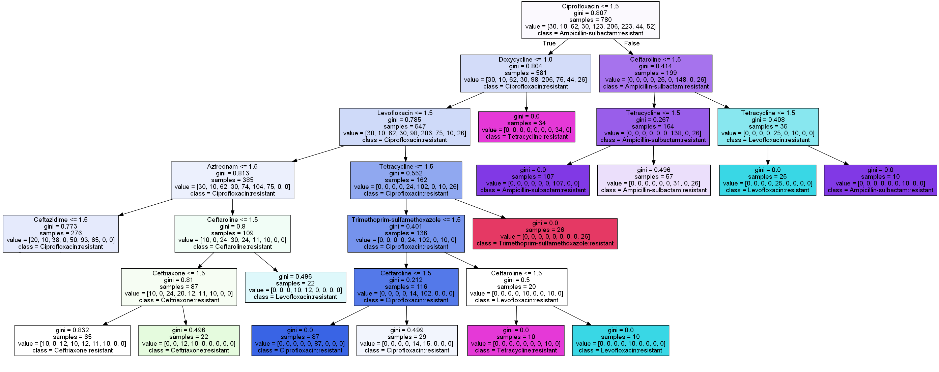
Application of Decision Tree
1-> Susceptible
2-> Intermediate
3-> Resistant

Slide 52
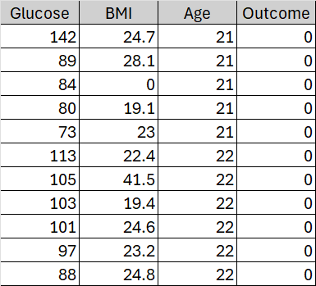
Assignment 2
Create a binary decision tree using Gini index impurity measure over the diabetes dataset to predict Outcome (as the label) by other attributes (as features).
Consider the following ranges of values for hyper-parameters:
max_depth = [3, 5]
min_sample_split= [5, 10]
min_samples_leaf= [3, 5]
min_impurity_decrease = [0.01, 0.001]
ccp_alpha = [0.001, 0.0001]
Spilt data into train, test, and validation (72%, 20%, 8%) and use validation data to select best hyper-parameter.
Calculate accuracy of the best Dtree on test data.
Extract three rules from the decision tree.

